Slide 1
Codebasics Resume Project Challenge – Data Analytics Project on Telangana Government

Slide 2
Data Analytics Project on Telangana Government
This Project is a Code basics Resume Project Challenge run by Code basics. Hundreds of participants across the world participate in this and their work is then recognized by the Code basics team and their connections on LinkedIn worldwide.
The 3 basic requirements for completing the challenge are:
Enrolling the project on the Codebasics website.
Completing the project using the tools of your choice.
Then publishing your work online on LinkedIn with the presentation.

Slide 3
About The Project
The Project is based on the real-time datasets of Telangana Government.
TELANGANA GOVERNMENT
Telangana is one of the fastest-growing states in India and one of the states with an open data policy.
Peter Pandey is an aspiring data analyst looking for a project with real-time data to add to his portfolio. He wanted to analyze Telangana’s growth among different sectors quantitatively and provide useful Insights to the Telangana government that would help them to make data-informed decisions that would further support the growth of the state.
Peter Pandey Data Analyst to convert real-time data sets to meaningful insights where Telangana Government can use for further growth of the state.

Slide 4
Objective
Explore Stamp Registration, Transportation and Ts-Ipass Datasets.
Understand their attributes, categories and time period.
• Analyze trends and patterns within each department.
• Identify growth opportunities and areas needing attention.
• Find correlation among these departments and report the overall growth of the state through insights and relevant visuals such as shape maps.

Slide 5
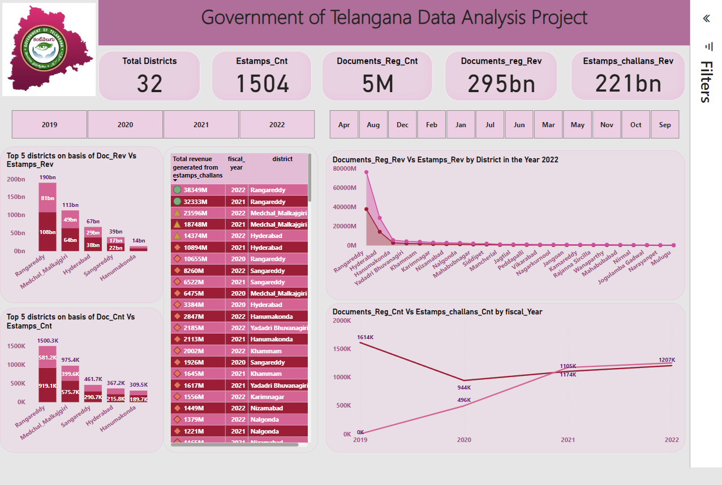
Live Interactive DasHboard
How does the revenue generated from document registration vary across districts in Telangana? List down the top 5 districts that showed the highest document registration revenue growth between FY 2019 and 2022.
Overall Total Revenue from Documents registered are leading the market compared to the Revenue from E-stamps.
Rangareddy district currently tops overall districts of Telangana currently at 190bn in terms of revenue generation compared to other districts. Top 5 districts are Rangareddy, Medchal Malkajgiri, Sangareddy, Hyderabad, Hanumakonda.
2. How does the revenue generated from document registration compare to the revenue generated from e-stamp challans across districts? List down the top 5 districts where e-stamps revenue contributes significantly more to the revenue than the documents in FY 2022?
Rangareddy district currently tops overall districts of Telangana currently at 38349M in terms of revenue generation from E-challans compared to Documents Registration Revenue. Top 5 districts in the year FY 2022 are Rangareddy, Hyderabad, Hanumakonda,Yadadri Bhuvanagiri,Khammam.

Slide 6
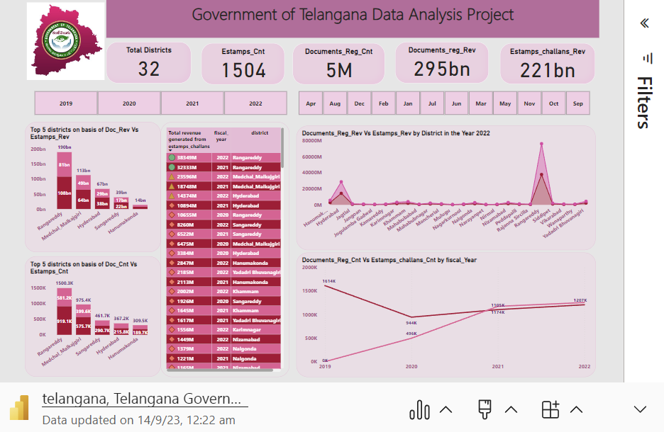
Data Analysis On E-stamps
3. Is there any alteration of e-stamp challan count and document registration count pattern since the implementation of e-stamp challan? If so, what suggestions would you propose to the government?
Overall total no of e-stamps is currently at 1504, total no of e-stamps for the month of sept is significantly lower than other segments at 96.
4. Categorize districts into three segments based on their stamp registration revenue generation during the fiscal year 2021 to 2022.
Rangareddy district has also been leading in terms of revenue from e-stamps both in the year 2021 and 2022.

Slide 7
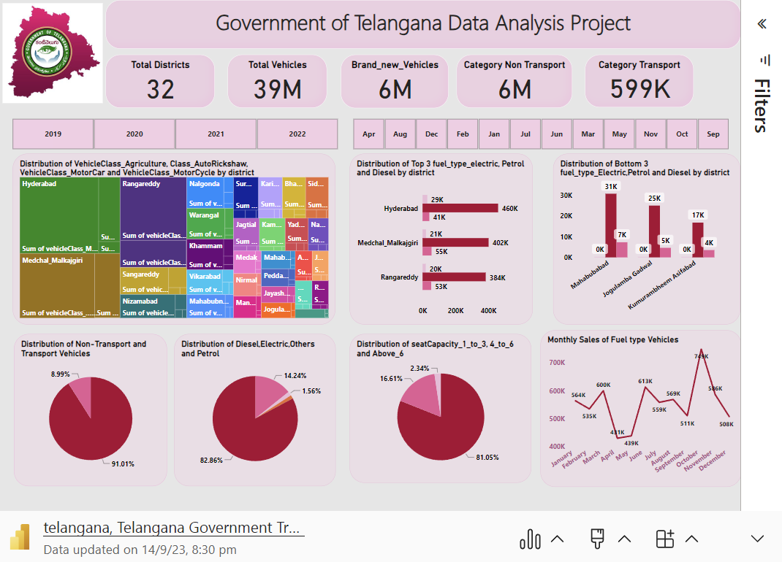
Data Analysis On Transportation
5. Investigate whether there is any correlation between vehicle sales and specific months or seasons in different districts. Are there any months or seasons that consistently show higher or lower sales rate, and if yes, what could be the driving factors? (Consider fuel-type category only)
There is a positive correlation between Vehicles Sales ,October month and districts of Telangana such as Hyderabad, Malkajgiri, sangareddy, Rangareddy. Overall Fuel Type Vehicles Sales been the highest in the month of October, except in the year 2022.The October month is festive season, hence more exciting offers (loan offers & discounts)leading to highest sales during this period. The Vehicles sales reached also have been lowest in the month of February, March ,April and May (No Offers, Union budget may impact overall market slowdown may be one of the factors of lowest sales.
6. How does the distribution of vehicles vary by vehicle class (motorcycle, motorcar, autorickshaw, agriculture) across different districts? Are there any districts with a predominant preference for a specific vehicle class? Consider FY 2022 for analysis.
In the Year 2022 MotorCycle in Hyderabad are predominantly used, compared to the other vehicle classes. Motorcycle was predominantly used and Autorickshaw was least used Vehicles among all.

Slide 8
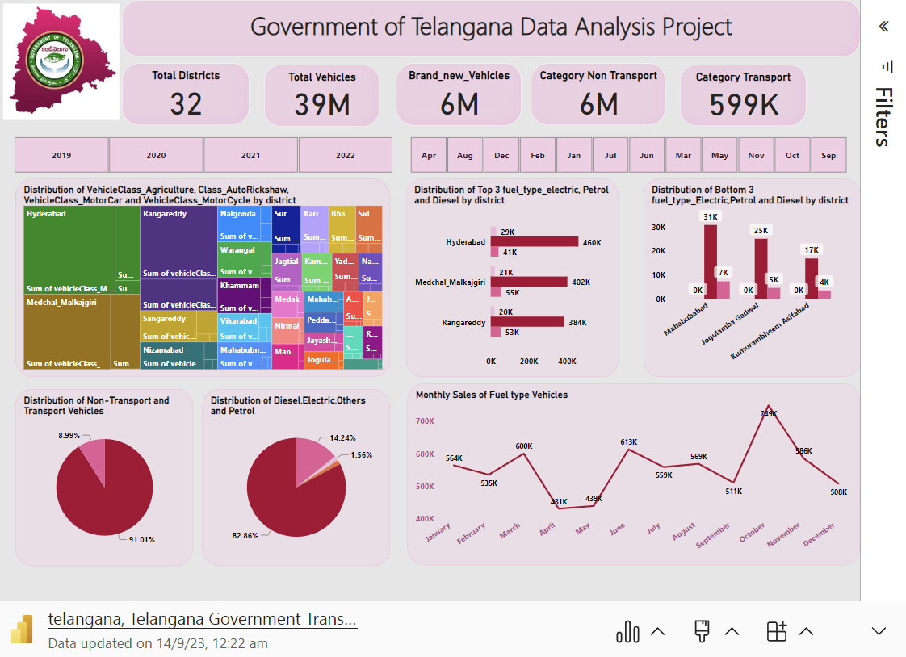
DATA ANALYSIS ON TRANSPORTATION
7. List down the top 3 and bottom 3 districts that have shown the highest and lowest vehicle sales growth during FY 2022 compared to FY 2021? (Consider and compare categories: petrol, diesel and electric)
Top 3 districts that have shown the highest Petrol Vehicles Sales growth during the Year 2022 are Rangareddy, Medchal Malkajgiri,Hyderabad.
Bottom 3 districts that have shown the lowest Electric and others Vehicles Sales during the Year 2022 and Lowest Sales Districts are Mahabubabad, Jagulamba Gadwal, Kumurambheem Asifabad. Only 4.42% of Electric Vehicles Sales been achieved and 2.56% of Others Vehicles Sales happened in the Year 2022.

Slide 9
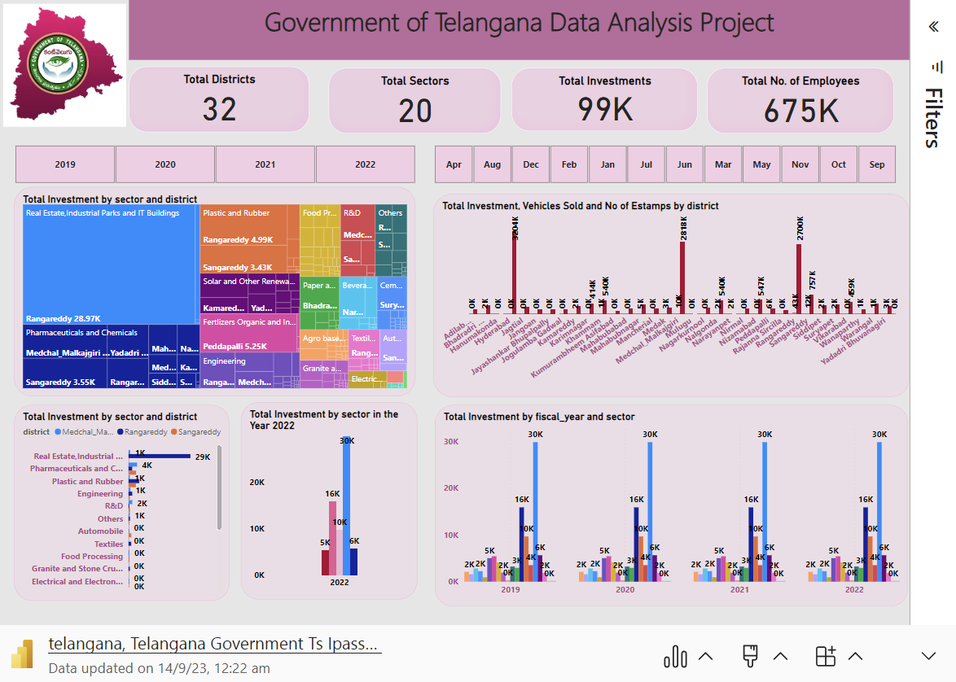
DATA ANALYSIS ON INDUSTRIAL PROJECT
8. List down the top 5 sectors that have witnessed the most significant investments in FY 2022.
Top 5 Sectors that have witnessed the most significant investments in the year 2022 are Real estate, Industrial Parks and IT buildings, Pharmaceutical and chemicals, Solar and other Renewable Energy and Fertilizers organic and inorganic, Pesticides, and other Related respectively.
9. List down the top 3 districts that have attracted the most significant sector investments during FY 2019 to 2022? What factors could have led to the substantial investments in these particular districts?
Top 3 districts are Rangareddy, Medchal Malkajgiri, Sangareddy where Total amount invested to Rangareddy District. Major part of amount been invested in Real Estate Development. The factors might be migration, income level of the people been changed, Growth in the field of Real Estate.
10. Is there any relationship between district investments, vehicles
Sales and stamps revenue within the same district between FY 2021
And 2022?
There is no relationship between district investments, vehicles
Sales and stamps revenue within the same district FY 2021
And 2022 because Total investment in all sectors been same in all the years and Vehicles sales and investment does not have correlation.

Slide 10
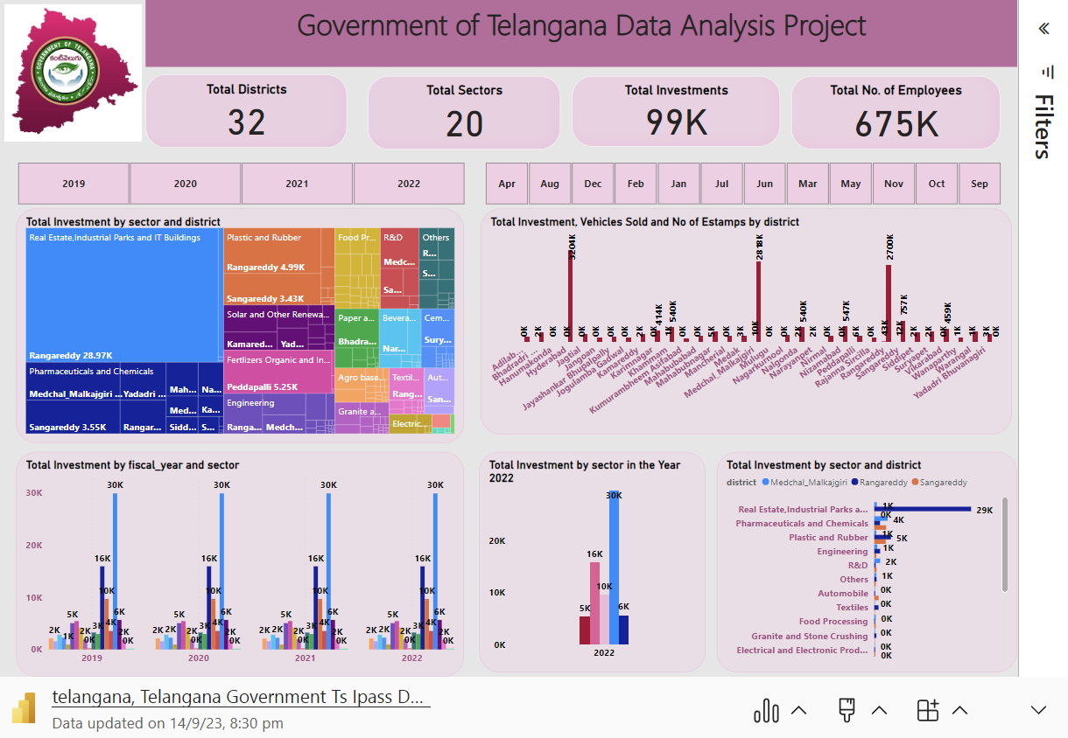
DATA ANALYSIS ON INDUSTRIAL PROJECT
11. Are there any particular sectors that have shown substantial
Investment in multiple districts between FY 2021 and 2022?
Pharmaceutical and chemicals Sector have been shown substantial investment in multiple districts in the Year of 2021 and 2022.
12. Can we identify any seasonal patterns or cyclicality in the
Investment trends for specific sectors? Do certain sectors
Experience higher investments during particular months?
Total Investment being maintained Same in all the Years. Real Estate Experience higher investments. Hence could not find any trends for specific Sectors.

Slide 11
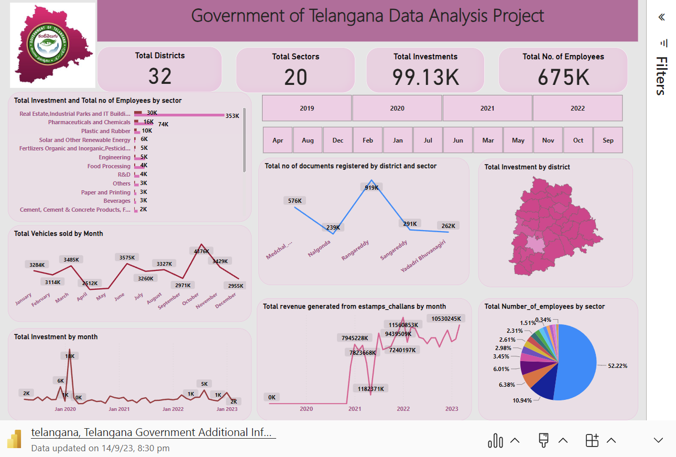
DATA ANALYSIS ON INDUSTRIAL PROJECT
1. What are the top 5 districts to buy commercial properties in Telangana? Justify your answer.
Top 5 districts to buy commercial properties would be Rangareddy, Medchal Malkajgiri, Sangareddy, Hyderabad, Hanumakonda due to major part of total investment invested in Real Estate Sector and fact and figures of Documents registration revenue also shows the trend and overall growth of the Real Estate Sector.
2. What significant policies or initiatives were put into effect to enhance economic growth, investments, and employment in Telangana by the current government? Can we quantify the impact of these policies using available data?
Only around 2% of total Investments made to R&D and Solar energy Products which seems there is great opportunity in the field of research & sales to enhance the Economic growth.

Slide 12
Insights & Recommendations
Real estate and pharma sector have more scope towards growth and development of telangana government.
Overall revenue generated from the district rangareddy.
In the fy 2022 rangareddy achieved 76bn from estamps and documents registration revenue and total investment made to district is minimal. Hence more the investment there is more growth perspective .
Major part of amount been invested in real estate development. The driving factors for development of real estate migration, income level of the people been changed, growth in the field of real estate.
Only around 2% of total investments made to R&D and solar energy products which has more scope if Telangana Government invest more on Research and Development.

Slide 13
THANK YOU

